Slide 1
A survey of plasma irregularities seen by the mid-latitude Blackstone SuperDARN radar
A. J. Ribeiro [1], J.M. Ruohoniemi [1], J.B.H. Baker [1], L.B.N. Clausen [1], R.A. Greenwald [1], M. Lester [2]
[1] Bradley Department of Electrical and Computer Engineering, Virginia Tech, Blacksburg, Virginia, USA
[2] Department of Physics and Astronomy, University of Leicester, UK
SuperDARN Workshop 2011
AJ Ribeiro (Space@VT)
Mid-Latitude Irregs.
Short Meeting Title, Date

Slide 2
Outline
Outline
Background
Dataset
Observations
Convection Patterns
Conclusions
AJ Ribeiro (Space@VT)
SuperDARN 2011
06/02/11

Slide 3
Mid-latitude Irregularities
Background
Mid-latitude Irregularities
SuperDARN expanded equatorward in 2004 with the construction of the Wallops Island radar at L = 2.4
The reason for the expansion was to provide coverage of the auroral oval as it expanded equatorward during storm-time
Surprisingly, quiet time irregularities were observed very frequently
The type of plasma irregularities frequently observed by the SuperDARN radars were first described by Greenwald et al. [2006] in a case study
They noted that the irregularities had Doppler velocities and spectral widths in the 10s of m/s
They also noted that the irregularities were observed with great frequency (> 50 % of nights)
AJ Ribeiro (Space@VT)
SuperDARN 2011
06/02/11

Slide 4
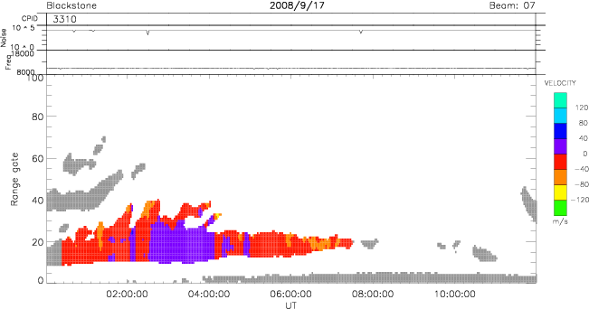
Mid-Latitude Irregularities
Dataset
Dataset
Ribeiro et al. [2011] described a way to reliably identify periods of ionospheric scatter in mid-latitude data
This allows for a statistical analysis of the irregularities
In order to select for quiet time irregularities, ionospheric events are separated by their velocity profile
If the 97th percentile of the distribution is below 120 m/s and the 3rd percentile is above -120 m/s, the event is flagged as low-velocity
Otherwise it is flagged as high-velocity
A range-time plot of a low-velocity event used in this analysis
AJ Ribeiro (Space@VT)
SuperDARN 2011
06/02/11

Slide 5
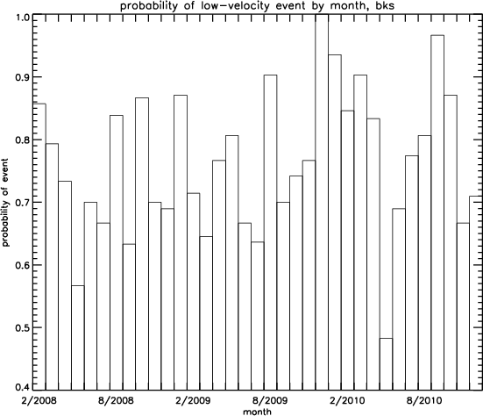
Mid-Latitude Irregularities
Observations 1
Frequency of occurrence
Three years of data (2008-2010) from the Blackstone radar was searched for ionospheric events, and separated into high- and low-velocity types
The figure shows the probability of occurrence of low-velocity events, organized by month
The probability is quite variable, but 70% is a typical value
AJ Ribeiro (Space@VT)
SuperDARN 201
06/02/11

Slide 6
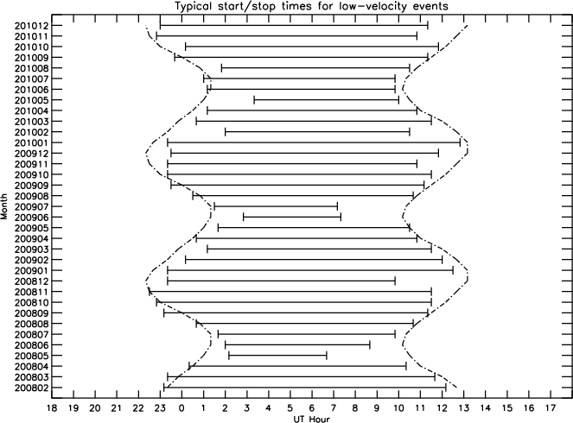
Mid-Latitude Irregularities
Observations 2
Local Time Dependence
The figure to the left shows typical start/stop times of low-velocity ionospheric scatter seen by the Blackstone radar and sunset/sunrise for Chicago
The start and stop times coincide very well with sunset and sunrise
Greenwald et al. [2006] suggested that a conducting E region was responsible for shorting out electric fields needed for the generation of irregularities
It is also possible that the ionosphere is too dense at mid-latitudes during the day for the rays to penetrate to F region altitudes
AJ Ribeiro (Space@VT)
SuperDARN 2011
06/02/11

Slide 7
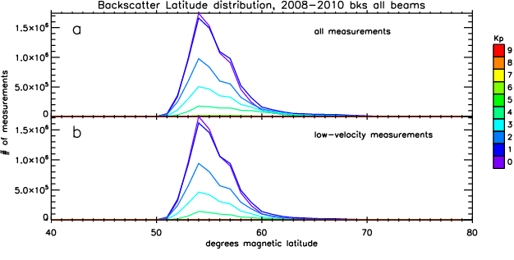
Mid-Latitude Irregularities
Observations 3
Latitude Distribution
The mid-latitude ionospheric irregularities seem to be nearly fixed in magnetic latitude
This is especially true for the low-velocity events
This suggests that the mid-latitude ionosphere is filled with these irregularities
The latitude at which they are observed is simply a result of propagation conditions
Magnetic latitude distribution of ionospheric irregularities
AJ Ribeiro (Space@VT)
SuperDARN 2011
06/02/11

Slide 8
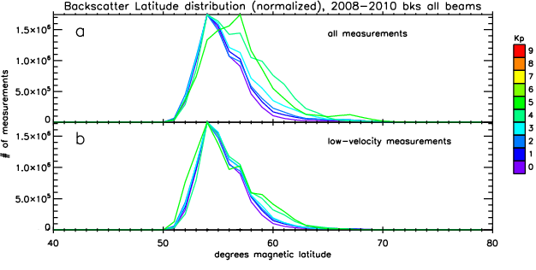
Mid-Latitude Irregularities
Observations 4
Latitude Distribution
Normalized magnetic latitude distributions for the ionospheric irregularities
AJ Ribeiro (Space@VT)
SuperDARN 2011
06/02/11

Slide 9
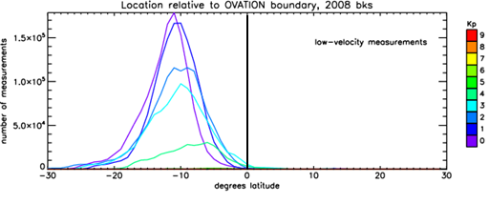
Mid-latitude Irregularities
Observations 5
Comparison to Auroral Oval
OVATION is a technique that approximates the boundaries of the auroral oval [Newell et al., 2002]
Using the OVATION equatorward boundary locations, we compared the location of the irregularities to the auroral oval
The low-velocity events are subauroral and fixed in latitude as the oval expands equatorward
Distribution of latitude relative to the auroral oval for high and low-velocity events
AJ Ribeiro (Space@VT)
SuperDARN 2011
06/02/11

Slide 10
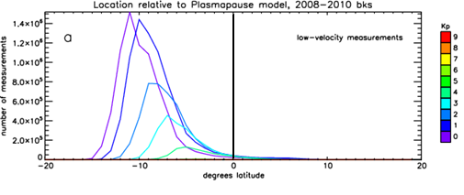
Mid-Latitude Irregularities
Observations 6
Comparison to Plasmapause
Moldwin et al. [2002] used CRESS measurements to develop a model for the location of the plasmapause
When compared with the plasmapause model, the low velocity events are shown to be equatorward of the plasmapause
This means that they lie on field lines that are conjugate to the plasmapause
Distribution of latitude relative to the plasmapause model for high and low-velocity events
AJ Ribeiro (Space@VT)
SuperDARN 2011
06/02/11

Slide 11
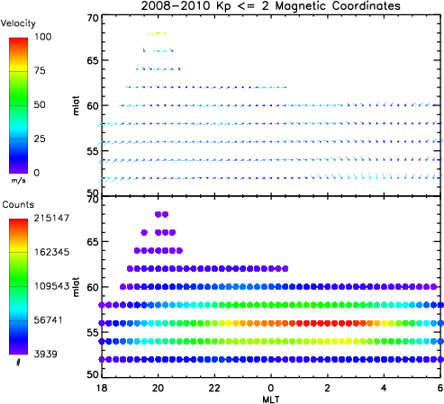
Mid-Latitude Irregularities
Convection Patterns
Convection patterns
In order to generate convection patterns, 3 years of BKS data and 1 year of FHE data are binned by MLT, MLAT, and Azimuth
Vectors are fit to these bins
For quiet-time, predominantly westward flow across the nightside
Eastward turning before dawn
AJ Ribeiro (Space@VT)
SuperDARN 2011
06/02/11

Slide 12
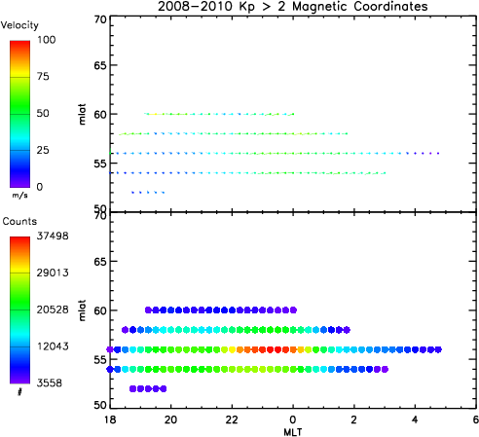
Mid-Latitude Irregularities
Convection Patterns 2
Convection patterns
During more disturbed periods, number of points is fewer
Pattern is basically the same
Westward convection across most of the nightside
Apparent eastward turning before dawn
AJ Ribeiro (Space@VT)
SuperDARN 2011
06/02/11

Slide 13
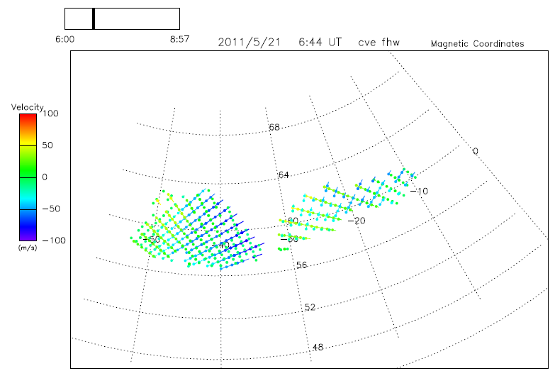
Mid-Latitude Irregularities
Convection Patterns 3
Overlapping FOV
Overlapping fields of view of BKS and FHE, as well as FHW and CVE allow for common-volume analysis
AJ Ribeiro (Space@VT)
SuperDARN 2011
06/02/11

Slide 14
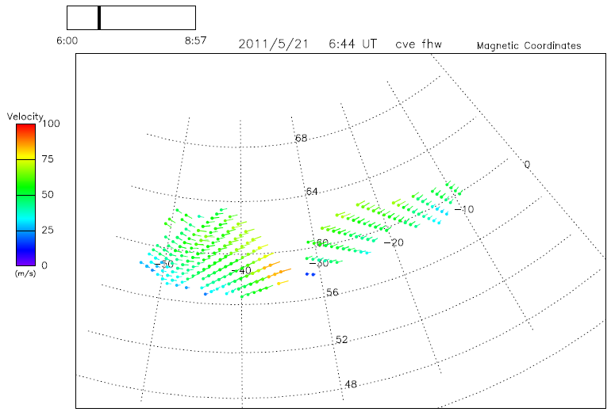
Mid-Latitude Irregularities
Convection Patterns 3
Overlapping FOV
With these overlapping fields of view, we can get true 2-D velocities for convection mapping for use in patterns, or in case studies
AJ Ribeiro (Space@VT)
SuperDARN 2011
06/02/11

Slide 15
Mid-Latitude Irregularities
Conclusions
Conclusions
The ionospheric scatter that is classified as low-velocity is equatorward of both the auroral oval and the plasmapause
These irregularities lie on closed field lines that map out to the plasmasphere
The mid-latitude SuperDARN radars can be used to study convection patterns in the plasmasphere
Common-volume analysis can provide 2-D flows
Comparison of radar backscatter with TEC could prove useful
AJ Ribeiro (Space@VT)
SuperDARN 2011
06/02/11

Slide 16
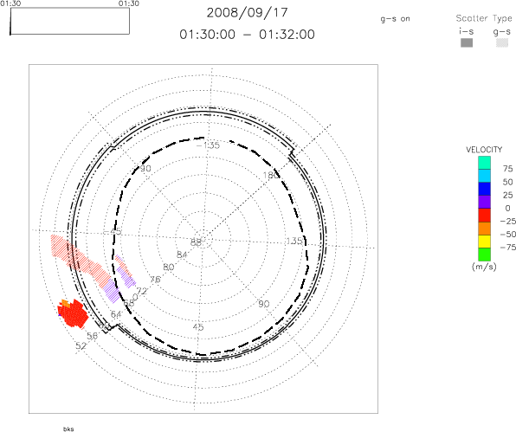
Mid-Latitude Irregularities
Questions?
AJ Ribeiro (Space@VT)
SuperDARN 2011
06/02/11

Slide 17
Mid-Latitude Irregularities
References
Greenwald, R. A., K. Oksavik, P. J. Erickson, F. D. Lind, J. M. Ruohoniemi, J. B. H. Baker, and J. W. Gjerloev (2006), Identification of the temperature gradient instability as the source of decameter-scale ionospheric irregularities on plasmapause field lines, Geophys. Res. Lett., 33, L18105, doi:10.1029/2006GL026581.
Moldwin, M. B., L. Downward, H. K. Rassoul, R. Amin, and R. R. Anderson (2002), A new model of the location of the plasmapause: CRRES results, J. Geophys. Res., 107(A11),1339,doi:10.1029/2001JA009211.
Newell, P. T., T. Sotirelis, J. M. Ruohoniemi, J. F. Carbary, K. Liou, J. P. Skura, C. - I. Meng, C. Deehr, D. Wilkinson, and F. J. Rich (2002), OVATION: Oval variation, assessment, tracking, intensity, and online nowcasting, Ann. Geophys., 20, 1039-1047, doi:10.5194/angeo-20-1039-2002.
AJ Ribeiro (Space@VT)
SuperDARN 2011
06/02/11

